Slide 1

MonetDB/X100 hyper-pipelining query execution
Peter Boncz, Marcin Zukowski, Niels Nes

Slide 2

Contents
Introduction
  Motivation
  Research: DBMS ⬄Computer Architecture
Vectorizing the Volcano Iterator Model
  Why & how vectorized primitives make a CPU happy
Evaluation TPC-H SF=100
  10-100x faster than DB2 (?)
The rest of the system
Conclusion & Future Work

Slide 3
Motivation
Application areas
  OLAP, data warehousing
  Data-mining in DBMS
  Multimedia retrieval
  Scientific Data (astro,bio,..)
Challenge: process really large datasets within DBMS efficiently

Slide 4
Research Area
Database Architecture
  DBMS design, implementation, evaluation
  vs Computer Architecture
    Data structures
    Query processing algorithms
MonetDB (monetdb.cwi.nl)
  1994-2004 at CWI
  Now: MonetDB/X100

Slide 5
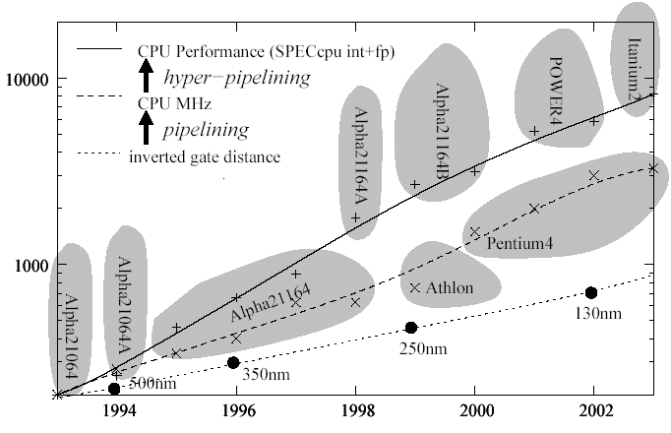
Scalar ➔ Super-Scalar
“Pipelining” ➔ “Hyper-Pipelining”

Slide 6
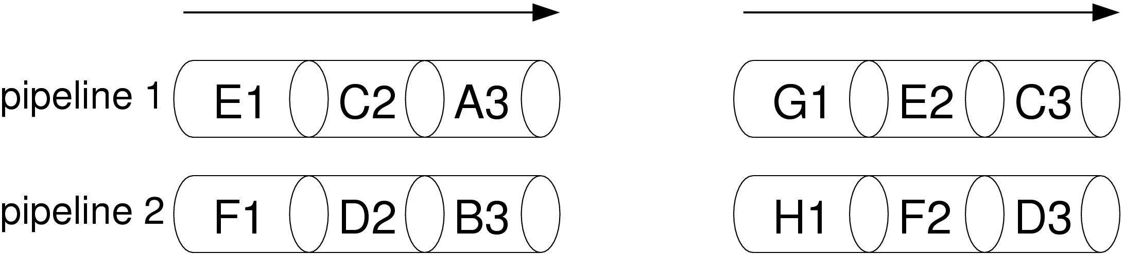
CPU
From CISC to hyper-pipelined
  1986: 8086: CISC
  1990: 486: 2 execution units
  1992: Pentium: 2 x 5-stage pipelined units
  1996: Pentium3: 3 x 7-stage pipelined units
  2000: Pentium4: 12 x 20-stage pipelined execution units
Each instruction executes in multiple steps…
  A -> A1, …, An
… in (multiple) pipelines:
CPU clock cycle
G
A
H
B

Slide 7
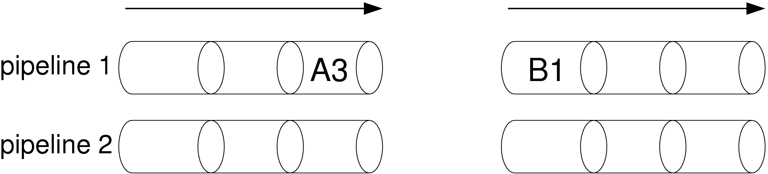
CPU
But only, if the instructions are independent! Otherwise:
Problems:
  branches in program logic
  instructions depend on each others results
[ailamaki99,trancoso98..] ➔DBMS bad at filling pipelines

Slide 8
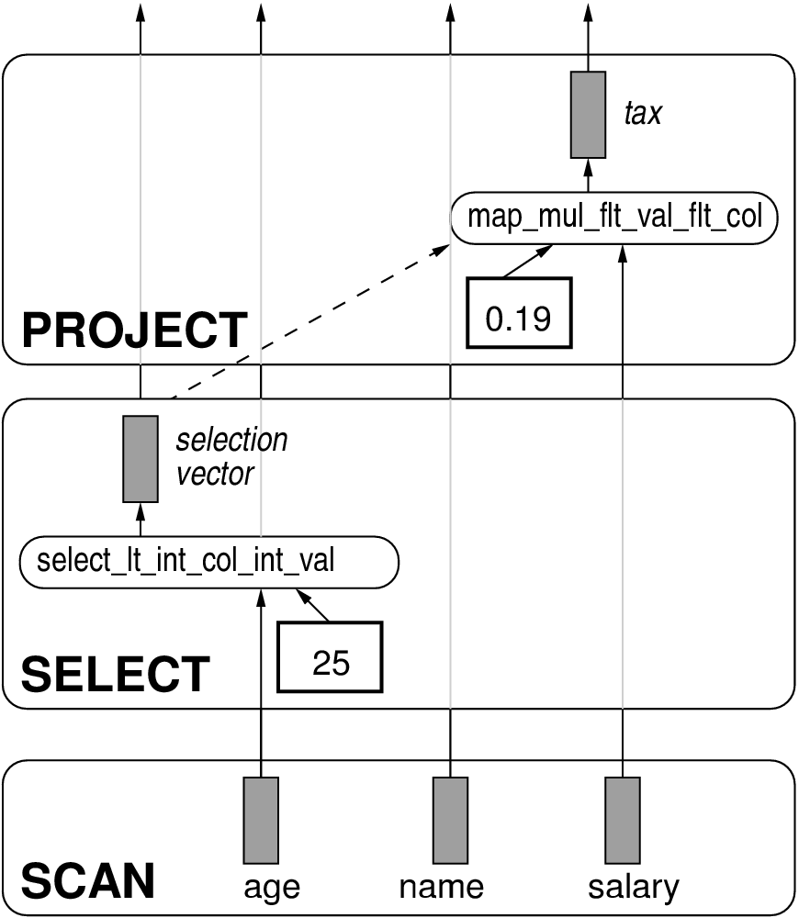
Volcano Refresher
Query
SELECT
name,
salary*.19 AS tax
FROM
employee
WHERE
age > 25

Slide 9
Volcano Refresher
Operators
Iterator interface
open()
next(): tuple
close()

Slide 10
Volcano Refresher
Primitives
Provide computational
functionality
All arithmetic allowed in
expressions,
e.g. multiplication
mult(int,int) ➔ int

Slide 11
Tuple-at-a-time Primitives
*(int,int): int
void
mult_int_val_int_val(
int *res, int l, int r)
{
*res = l * r;
}
LOAD reg0, (l)
LOAD reg1, (r)
MULT reg0, reg1
STORE reg0, (res)

Slide 12
Tuple-at-a-time Primitives
*(int,int): int
LOAD reg0, (l)
LOAD reg1, (r)
void
mult_int_val_int_val(
int *res, int l, int r)
{
*res = l * r;
}
MULT reg0, reg1
STORE reg0,(res)

Slide 13
Tuple-at-a-time Primitives
*(int,int): int
LOAD reg0, (l)
LOAD reg1, (r)
void
mult_int_val_int_val(
int *res, int l, int r)
{
*res = l * r;
}
MULT reg0, reg1
15 cycles-per-tuple
+ function call cost (~20cycles)
Total: ~35 cycles per tuple
STORE reg0,(res)

Slide 14
Vectors
Column slices as
unary arrays

Slide 15
Vectors
Column slices as
unary arrays

Slide 16
Vectors
Column slices as
unary arrays
NOT:
Vertical is a better table storage
layout than horizontal
(though we still think it often is)
RATIONALE:
- Primitives see relevant columns
only, not tables
- Simple array operations are
well-supported by compilers

Slide 17
x100: Vectorized Primitives
*(int,int): int ➔ *(int[],int[]) : int[]
void
map_mult_int_col_int_col(
int _restrict_*res,
int _restrict_*l,
int _restrict_*r,
int n)
{
for(int i=0; i<n; i++)
res[i] = l[i] * r[i];
}

Slide 18
x100: Vectorized Primitives
*(int,int): int ➔ *(int[],int[]) : int[]
void
map_mult_int_col_int_col(
int _restrict_*res,
int _restrict_*l,
int _restrict_*r,
int n)
{
for(int i=0; i<n; i++)
res[i] = l[i] * r[i];
}
Pipelinable
loop

Slide 19
x100: Vectorized Primitives
Pipelined loop, by C compiler
void
map_mult_int_col_int_col(
int _restrict_*res,
int _restrict_*l,
int _restrict_*r,
int n)
{
for(int i=0; i<n; i++)
res[i] = l[i] * r[i];
}
LOAD reg0, (l+0)
LOAD reg1, (r+0)
LOAD reg2, (l+1)
LOAD reg3, (r+1)
LOAD reg4, (l+2)
LOAD reg5, (r+2)
MULT reg0, reg1
MULT reg2, reg3
MULT reg4, reg5
STORE reg0, (res+0)
STORE reg2, (res+1)
STORE reg4, (res+2)

Slide 20
x100: Vectorized Primitives
Estimated throughput
2 cycles per tuple
1 function call (~20 cycles)
per vector (i.e. 20/100)
Total: 2.2 cycles per tuple
LOAD reg8, (l+4)
LOAD reg9, (r+4)
MULT reg4, reg5
STORE reg0, (res+0)
LOAD reg0, (l+5)
LOAD reg1, (r+5)
MULT reg6, reg7
STORE reg2, (res+1)
LOAD reg2, (l+6)
LOAD reg3, (r+6)
MULT reg8, reg9
STORE reg4, (res+2)

Slide 21
Memory Hierarchy
X100 query engine
Vectors are only the in-cache
representation
RAM & disk representation might
actually be different
(we use both PAX and DSM)
CPU
cache
RAM
ColumnBM
(buffer manager)
networked
ColumnBM-s
(raid)
Disk(s)

Slide 22
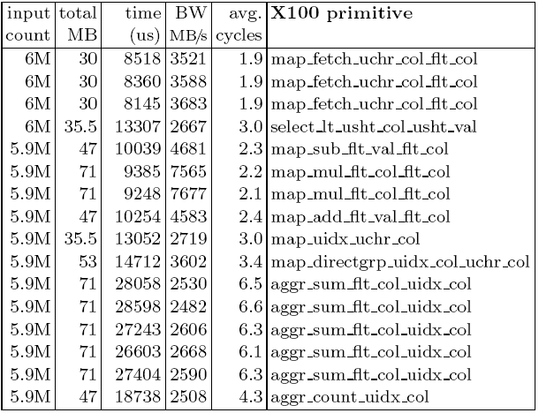
x100 result (TPC-H Q1)
as predicted

Slide 23
x100 result (TPC-H Q1)
Very low cycles-per-tuple

Slide 24
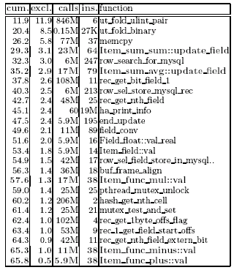
MySQL (TPC-H Q1)
Tuple-at-a-time processing
Compared with x100:
More ins-per-tuple
(even more cycles-per-tuple)
..

Slide 25
MySQL (TPC-H Q1)
One-tuple-at-a-time processing
Compared with x100:
More ins-per-tuple
(even more cycles-per-tuple)
  .

Slide 26
MySQL (TPC-H Q1)
One-tuple-at-a-time processing
Compared with x100:
More ins-per-tuple
(even more cycles-per-tuple)
Lot of “overhead”
  Tuple navigation / movement
  .

Slide 27
MySQL (TPC-H Q1)
One-tuple-at-a-time processing
Compared with x100:
More ins-per-tuple
(even more cycles-per-tuple)
Lot of “overhead”
  Tuple navigation / movement
  Expensive hash
.

Slide 28
MySQL (TPC-H Q1)
One-tuple-at-a-time processing
Compared with x100:
More ins-per-tuple
(even more cycles-per-tuple)
Lot of “overhead”
  Tuple navigation / movement
  Expensive hash
  NOT: locking
.

Slide 29
Optimal Vector size?
X100 query engine
All vectors together should fit
the CPU cache
Optimizer should tune this,
given the query characteristics.
CPU
cache
RAM
ColumnBM
(buffer manager)
networked
ColumnBM-s
(raid)
Disk(s)

Slide 30
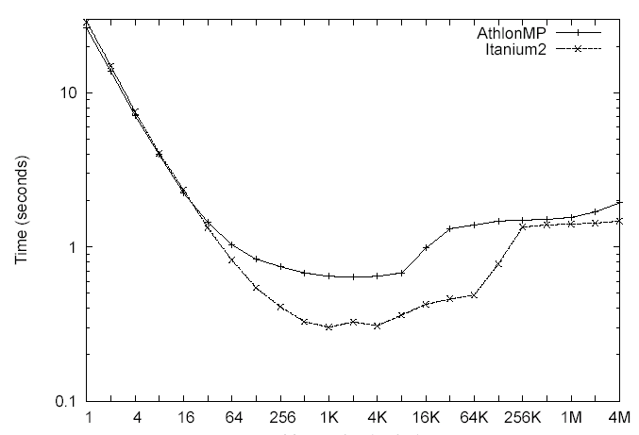
Vector size impact
Varying the vector size on TPC-H query 1

Slide 31
Vector size impact
Varying the vector size on TPC-H query 1
mysql,
oracle,
db2
low IPC,
overhead
MonetDB
RAM
bandwidth
bound
X100

Slide 32
MonetDB/MIL materializes columns
MonetDB/X100
MonetDB/MIL
CPU
cache
RAM
ColumnBM
(buffer manager)
networked
ColumnBM-s
(raid)
Disk(s)

Slide 33
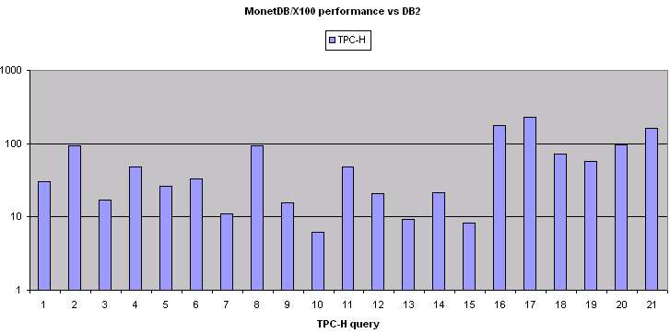
How much faster is it?
X100 vs DB2 official TPC-H numbers (SF=100)

Slide 34
Is it really?
X100 vs DB2 official TPC-H numbers (SF=100)
Smallprint
Assumes perfect 4CPU scaling in DB2
X100 numbers are a hot run, DB2 has I/O
  but DB2 has 112 SCSI disks and we just 1

Slide 35
Now: ColumnBM
A buffer manager for MonetDB
  Scale out of main memory
Ideas
  Use large chunks (>1MB) for sequential bandwidth
  Differential lists for updates
    Apply only in CPU cache (per vector)
  Vertical fragments are immutable objects
    Nice for compression
    No index maintenance

Slide 36
Problem - bandwidth
x100 too fast for disk (~600MB/s TPC-H Q1)

Slide 37
ColumnBM: Boosting Bandwidth
Throw everything at this problem
Vertical Fragmentation
  Don’t access what you don’t need
Use network bandwidth
  Replicate blocks in other nodes running ColumnBM
Lightweight compression
  With rates of >GB/second
Re-use Bandwidth
  If multiple concurrent queries want overlapping data

Slide 38
Summary
Goal: CPU efficiency on analysis apps
  Main idea: vectorized processing
RDBMS comparison
  C compiler can generate pipelined loops
  Reduced interpretation overhead
MonetDB/MIL comparison
  uses less bandwidth ➔ better I/O based scalability

Slide 39
Conclusion
New engine for MonetDB (monetdb.cwi.nl)
  Promising first results
  Scaling to huge (disk-based) data sets
Future work
    Vectorizing more query processing algorithms,
    JIT primitive compilation,
    Lightweight Compression,
    Re-using I/O

